Slide 1
gdb
Notes:
In this chapter we turn our attention specifically to buffer overflow attacks. This
type of attack is one of the most common attacks seen and results from careless
programming in applications. A look at the list of vulnerability advisories from
organizations such as CERT or SANS continue to include a significant number of
buffer overflow or heap overflow exploits, including a number of serious, remotely
exploitable vulnerabilities. Similarly, several of the items in the CWE/SANS Top 25
Most Dangerous Software Errors list, Risky Resource Management category, are
buffer overflow variants. These can result in exploits to both operating systems and
common applications, and still comprise the majority of exploits in widely deployed
exploit toolkits [VEEN12]. Yet this type of attack has been known since it was first
widely used by the Morris Internet Worm in 1988, and techniques for preventing
its occurrence are well known and documented.

Slide 2
What is gdb
“GNU Debugger”
A debugger for several languages, including C and C++
It allows you to inspect what the program is doing at a certain point during execution.
Errors like segmentation faults may be easier to find with the help of gdb.
http://sourceware.org/gdb/current/onlinedocs/gdb toc.html -online manual
Notes:
We begin with an introduction to the basics of buffer overflow. Then we
present details of the classic stack buffer overflow. This includes a discussion of
how functions store their local variables on the stack and the consequence of
attempting to store more data in them than there is space available. We continue
with an overview of the purpose and design of shellcode, which is the custom code
injected by an attacker and to which control is transferred as a result of the buffer
overflow.
Next we consider ways of defending against buffer overflow attacks. We start
with the obvious approach of preventing them by not writing code that is vulnerable
to buffer overflows in the first place. However, given the large, existing body
of buggy code, we also need to consider hardware and software mechanisms that
can detect and thwart buffer overflow attacks. These include mechanisms to protect
executable address space, techniques to detect stack modifications, and approaches
that randomize the address space layout to hinder successful execution of these
attacks.
Finally, we briefly survey some of the other overflow techniques, including
return to system call and heap overflows, and mention defenses against these.

Slide 3
Check gdb installation
Before you go for installation, check if you already have gdb installed on your Unix system by issuing the following command:
$gdb -help
If GDB is installed, then it will display all the available options within your GDB. If GDB is not installed, then proceed for a fresh installation.

Slide 4
Installation requirements
An ANSI-compliant C compiler (gcc is recommended - note that gdb can debug codes generated by other compilers)
115 MB of free disk space is required on the partition on which you're going to build gdb.
20 MB of free disk space is required on the partition on which you're going to install gdb.

Slide 5
Install
Use the following command to install gdb on linux machine.
$ sudo apt-get install libc6-dbg gdb valgrind

Slide 6
Compile a program
Normally, you would compile a program like:
gcc [flags] <source files> -o <output file>
For example:
gcc prog1.c -o prog1.x
Now you add a -g option to enable built-in debugging support
(which gdb needs):
gcc [other flags] -g <source files> -o <output file>
For example:
gcc -g prog1.c -o prog1.x

Slide 7
Start up
Just try “gdb ” or “gdb prog1.x .” You’ll get a prompt that looks like this:
(gdb)
If you didn’t specify a program to debug, you’ll have to load it in now:
(gdb) file prog1.x
Here, prog1.x is the program you want to load, and “file” is the command to load it.

Slide 8
help
gdb has an interactive shell, much like the one you use as soon as you log into the linux grace machines. It can recall history with the arrow keys, auto-complete words (most of the time) with the TAB key, and has other nice features.
Tip
If you’re ever confused about a command or just want more information, use the “help” command, with or without an argument:
(gdb) help [command]
You should get a nice description and maybe some more useful tidbits. . .

Slide 9
run
To run the program, just use:
(gdb) run
This runs the program.
If it has no serious problems (i.e. the normal program didn’t get a segmentation fault, etc.), the program should run fine here too.
If the program did have issues, then you (should) get some useful information like the line number where it crashed, and parameters to the function that caused the error:
Program received signal SIGSEGV, Segmentation fault.0x0000000000400524 in sum array region (arr=0x7fffc902a270, r1=2, c1=5, r2=4, c2=6) at sum-array-region2.c:12

Slide 10
Set breakpoints
Breakpoints can be used to stop the program run in the middle, at a designated point. The simplest way is the command “break .”
This sets a breakpoint at a specified file-line pair:
(gdb) break file1.c:6
This sets a breakpoint at line 6 , of file1.c . Now, if the program ever reaches that location when running, the program will pause and prompt you for another command.
Tip: You can set as many breakpoints as you want, and the program should stop execution if it reaches any of them.

Slide 11
More breakpoints
You can also tell gdb to break at a particular function. Suppose you have a function my func :
int my func(int a, char *b);
You can break anytime this function is called:
(gdb) break my func

Slide 12
Continue and step
Once you’ve set a breakpoint, you can try using the run command again. This time, it should stop where you tell it to (unless a fatal error occurs before reaching that point). You can proceed onto the next breakpoint by typing “continue” (Typing run again would restart the program from the beginning, which isn’t very useful.)
(gdb) continue
You can single-step (execute just the next line of code) by typing “step.” This gives you really fine-grained control over how the program proceeds. You can do this a lot...
(gdb) step

Slide 13
More commands
https://www.exploit-db.com/papers/13205/

Slide 14
firstprog
#include <stdio.h>
int main()
{
int i;
for(i=0; i<10; i++)
{
printf(“hello, world!\n”);
}
}

Slide 15
Demo
list
disassemble
break
Run
info register eip
x – examine memory
Format letter
o : octal
x : hexadecimal
u : base-10 decimal
t : binary
Size letter
b : a single byte
h : a halfword (2 bytes)
w : a word (4 bytes)
g : a giant (8 bytes)
For example: x/8xb
8
Hexadecimal
bytes

Slide 16
Demo
i – instruction
Example: x/2i $eip

Slide 17
Registers
General-purpose registers
-- temporary variables
EAX : Accumulator
ECX: Counter
EDX: Data
EBX: Base

Slide 18
Registers
General-purpose registers
-- pointers and indexes
ESP: Stack pointer
EBP: Base pointer
ESI: Source index
EDI: Destination index

Slide 19
Registers
EIP: Instruction pointer
Point to current instruction the processor is reading
EFLAGS: bit flags
For comparisons and memory segmentation

Slide 20
Memory Segments --fixed size
text segment
EIP points to the instruction the processor is reading
Read-only
Writing is a violation
Allow multiple executions
data segment
Initialized global and static variables
bss segment
Uninitialized global and static variables
Stack
Data
Code
Stack
Data
Code
OS

Slide 21
Memory Segments --variable size
heap segment
Programmer reserves and free memory on the fly
Grows to higher addresses
stack segment
Contains stack frames
Local variables
Context of function calls
ESP points to the end
Grows to lower addresses
stack frame
EBP(FP-frame pointer or LB-local base) points to the variable in the frame
Function parameters
Local variables
Saved frame pointer (SFP) and return address

Slide 22
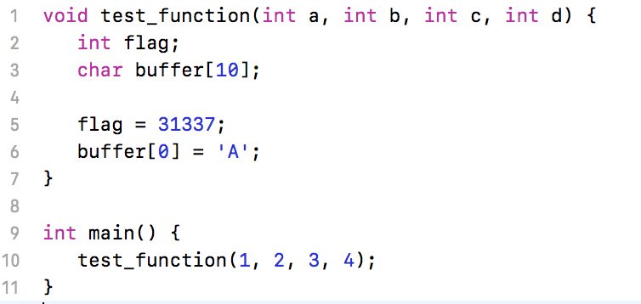
Stack Example

Slide 23
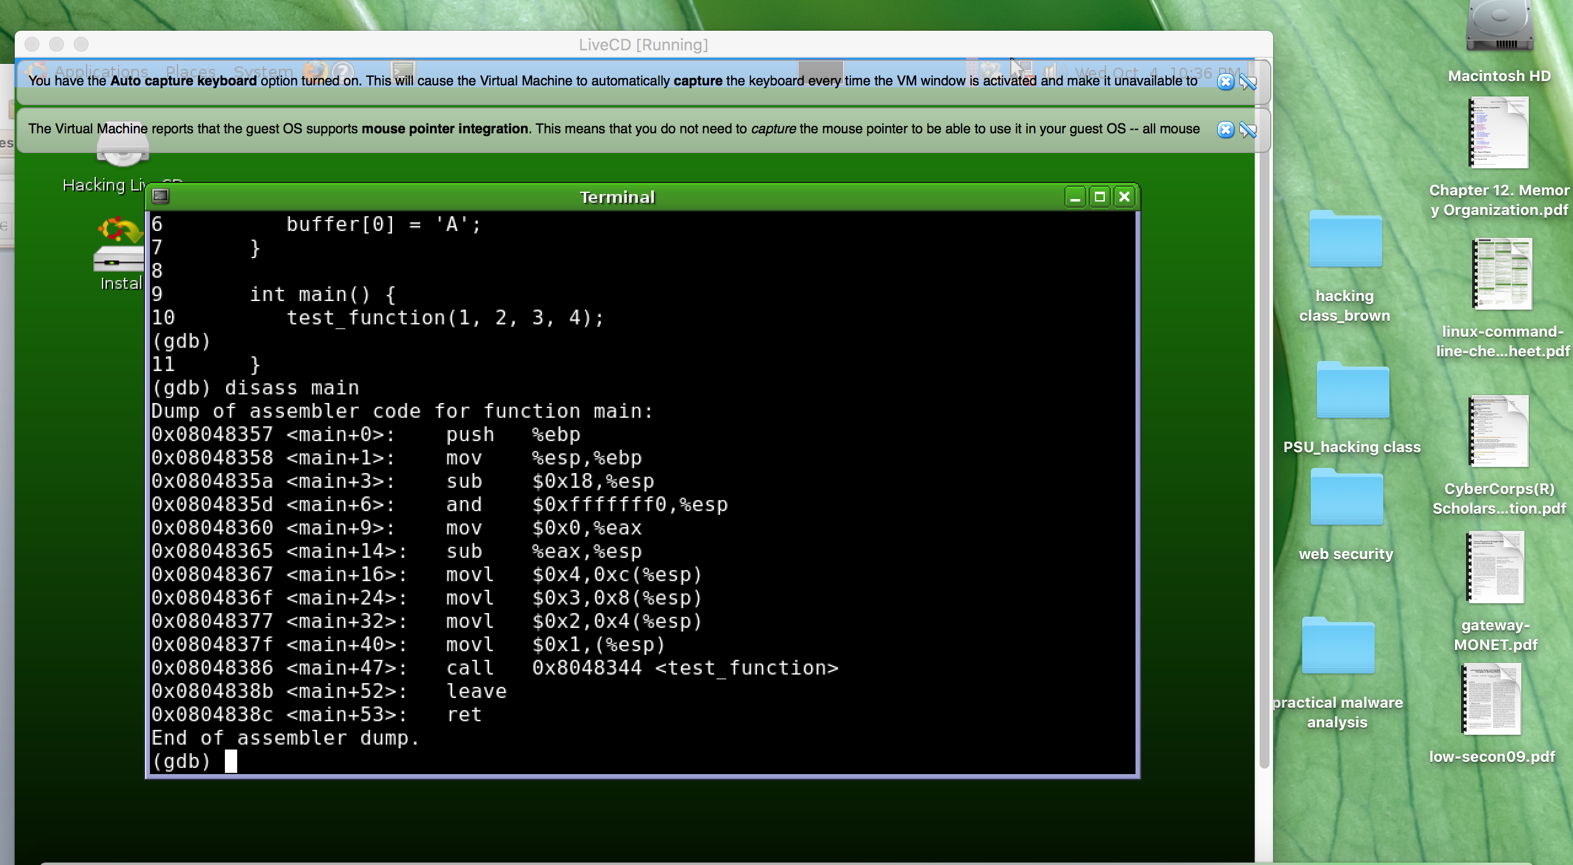

Slide 24
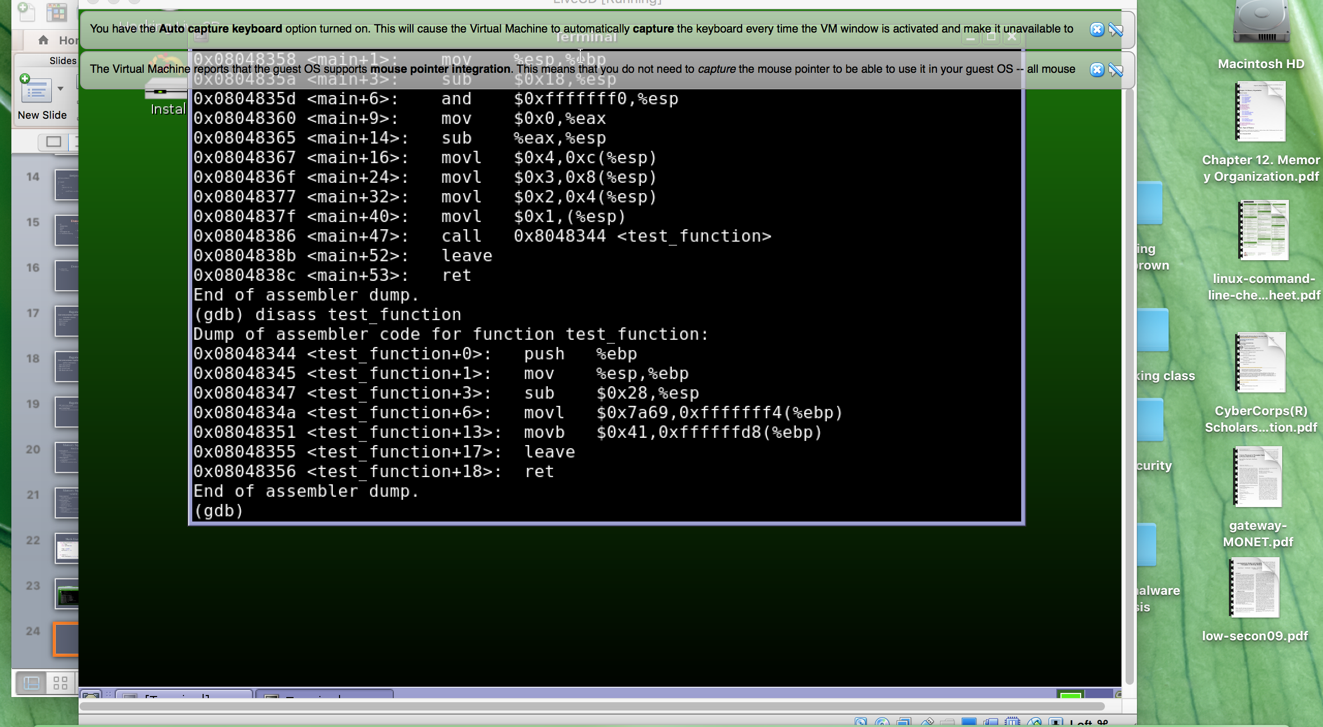

Slide 25
Demo
Top of Stack
Low addresses
Buffer
flag
Saved frame pointer (SFP)
Frame pointer (EBP)
Return address (ret)
a
b
c
d
High addresses
...

